Slide 1
SpyMeSat Mobile App
Imaging Satellite Awareness & Access
brought to you by

Slide 2
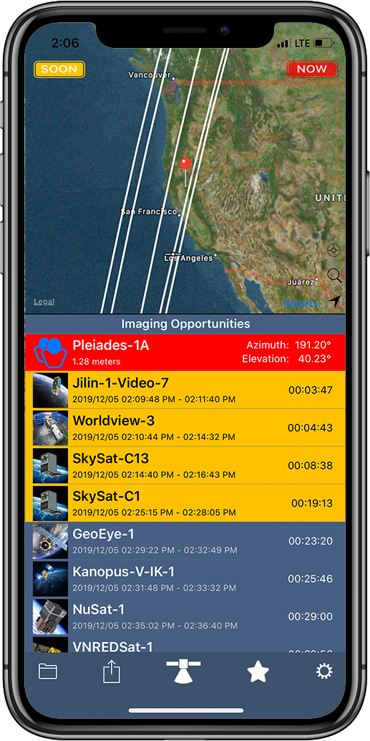
The SpyMeSat app . . . space awareness and access for everyone
The SpyMeSat app will notify you when a satellite could be taking your picture from space!
SpyMeSat is the first mobile app to offer instant access to the latest commercial satellite imagery through in-app purchase, and the first mobile app to allow users to request new tasking of an imaging satellite!
SpyMeSat uses published satellite orbit data from NORAD and publicly available satellite information to compute and dynamically display satellite flyovers and imaging opportunities.
Available for iPhone and Android

Slide 3
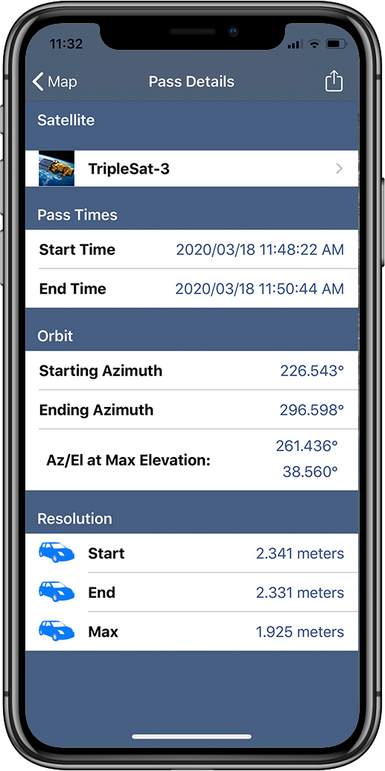
Pass Details
Select a pass from the list on the main page and the Pass Details page comes up
Pass Details provides additional information about a specific upcoming imaging opportunity including start and end times to 1 second fidelity, and starting, ending, and best imaging resolution
A link is also provided to find out more about the satellite

Slide 4
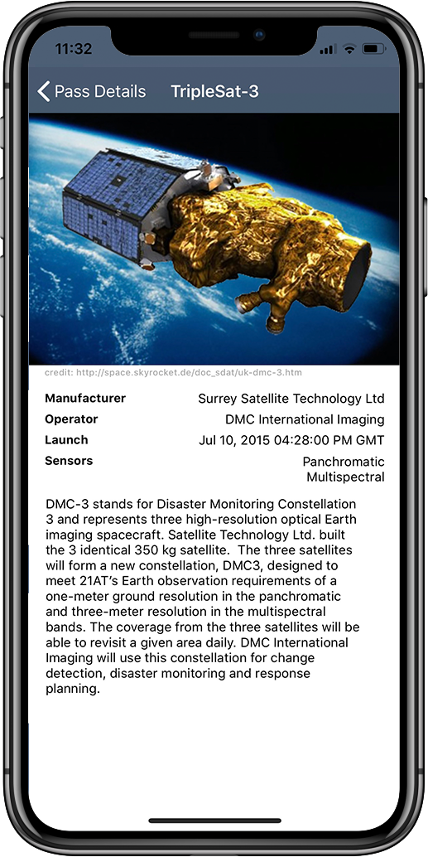
Satellite Information Pages
A separate page is provided for each satellite that includes a photo or artwork of the satellite and some background on its capabilities and operation
The Satellite Information page is reached from any pass details page or from the Settings satellite page

Slide 5
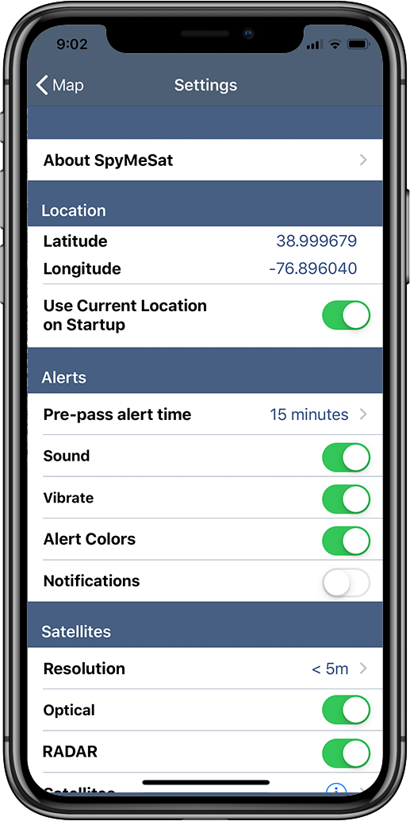
Settings
This app page is reached by selecting the configuration icon in the lower right of the main page
The user can set a variety of preferences:
Enable/Disable specific satellites
Set the resolution limit for notifications
Select and set notification options
Select period of time for computations
SpyMeSat imagery server login

Slide 6
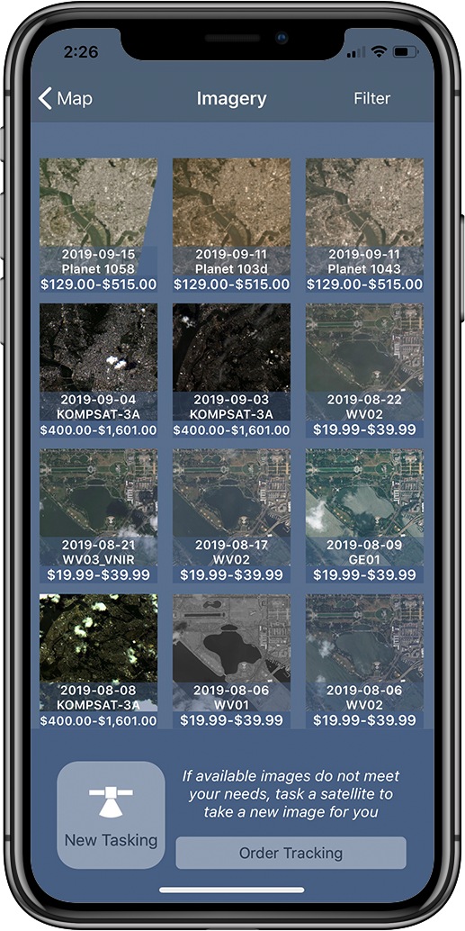
Preview Available Satellite Imagery
From the main SpyMeSat Imagery page, the user can thumbnails of available satellite images for the current specified SpyMeSat location
Images are identified by the date collected and ordered by date for easy searching
From this page the user selects an available image to preview . . . or chooses New Tasking

Slide 7
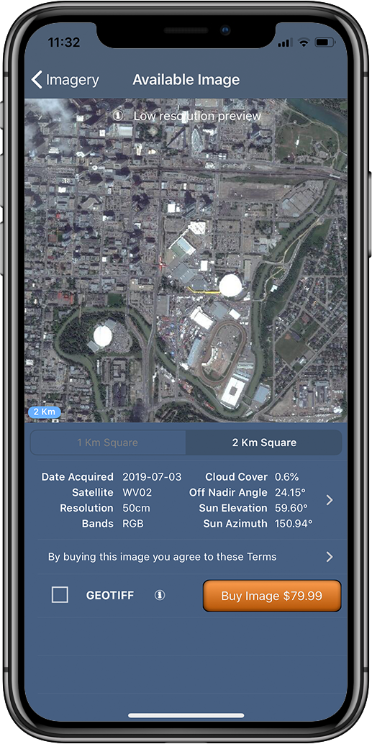
Download Satellite Images
The most recent and highest resolution commercial satellite imagery in the world is available for purchase through the SpyMeSat app
Preview a low resolution version of the available satellite images of your current location or any location you specify, select the desired image size, and click to purchase . . . As easy as buying a song!
Images come from the DigitalGlobe and Planet satellite imagery archives and are available on demand. Your purchased images are available in JPEG format on your smartphone within seconds, and also available for download in GEOTIFF format.
SpyMeSat is the first mobile app to offer on-demand download of high resolution satellite images
U.S. PATENTS 9344994 and 9779301

Slide 8
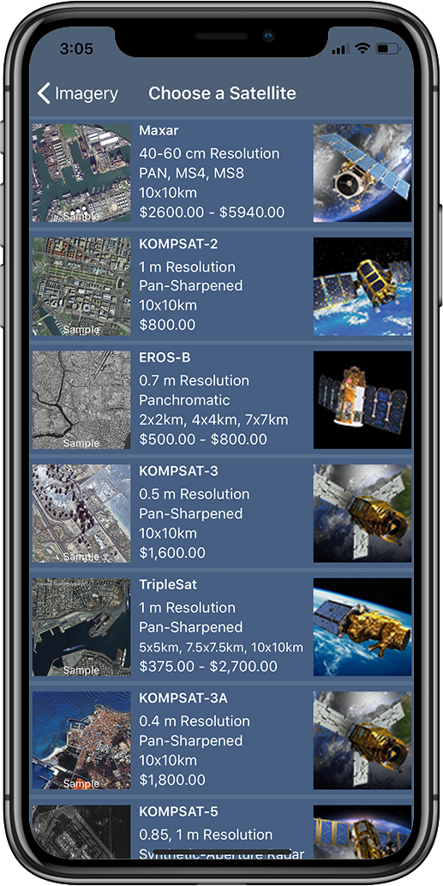
New Tasking (Choose a Satellite)
SpyMeSat users may request a new image be taken by a satellite . In the industry this is known as “New Tasking”
New Tasking has never before been available to the public through a mobile app
The first step for New Tasking is to select a satellite for tasking
Resolution, color, image size options, and pricing are summarized here for each satellite to help the user make a selection

Slide 9
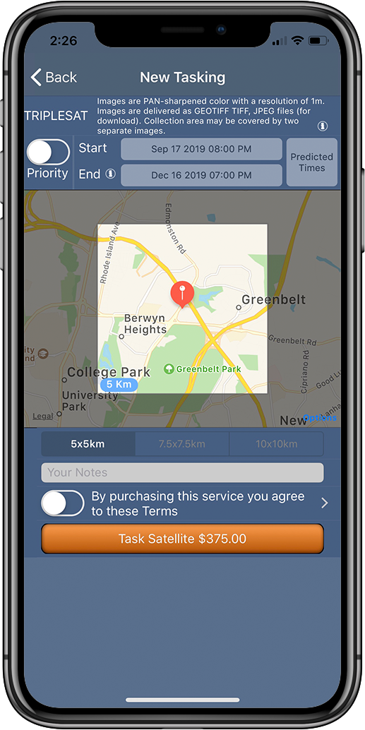
New Tasking
User selects the start and end dates for tasking (minimum day range applies for some satellites), and the size option, adds a note (optional), and hits Order Image.
Pricing ranges from $250-$5940 USD, depending on the satellite selected, and the size of the image requested.
Payments are made via Apple Pay or credit card
EULA is available from this order page (and from the archive image purchase page as well)
Images are collected by the EROS-B, TripleSat, Maxar, Planet, or KOMPSAT satellites:
40cm to 1m resolution
Color or Black & White or RADAR
JPEG image delivered for mobile app
Link provided via email to download GEOTIFF image
U.S. PATENTS 9344994 and 9779301

Slide 10
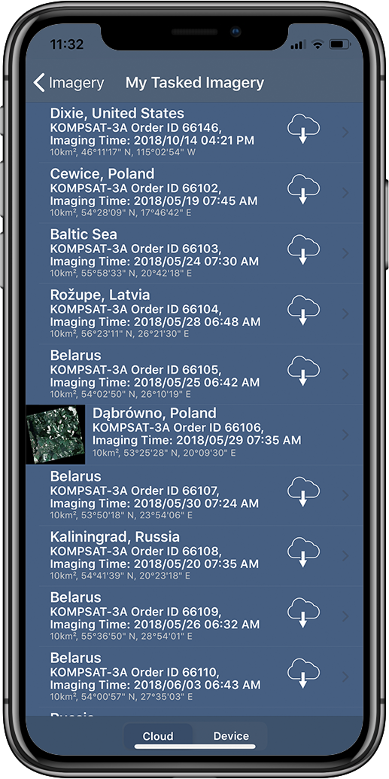
Tasking Status (and notifications)
The My Tasked Imagery page (reached from the Imagery page) provides the user status of all tasked images
Thumbnails of successfully collected images are shown, if available
Tasking notifications let the user know BEFORE IMAGING of the EXACT time of imaging for some satellites . . . enabling “space selfies” !!!
U.S. PATENTS 9344994 and 9779301

Slide 11
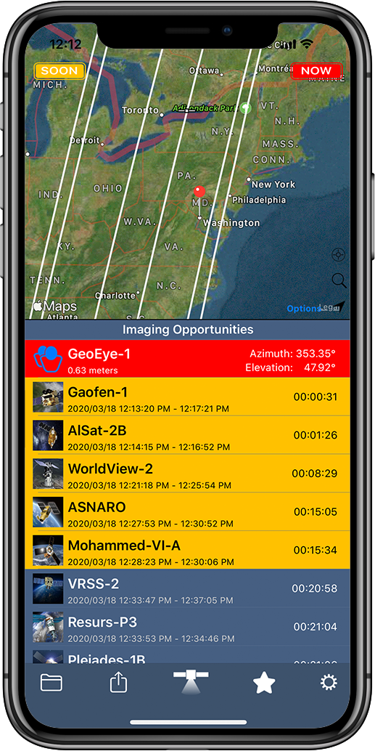
Setting Location
SpyMeSat uses the mobile devices current location
If Location Services are available
If “Use Current Location on Startup” is selected on the Settings page (default)
The user may change the specified location through the main map page by:
Scroll/zoom on the map and press/hold to drop a pin
Enter a specific location using the “Search” icon option (by landmark, address, or lat/lon)
Selecting the “Use Current Location” icon
Return to center the map on the set location and default zoon level using the “pointer” icon
Set the map background options (satellite, map, hybrid) using the “Options” button
U.S. PATENTS 9344994 and 9779301

Slide 12
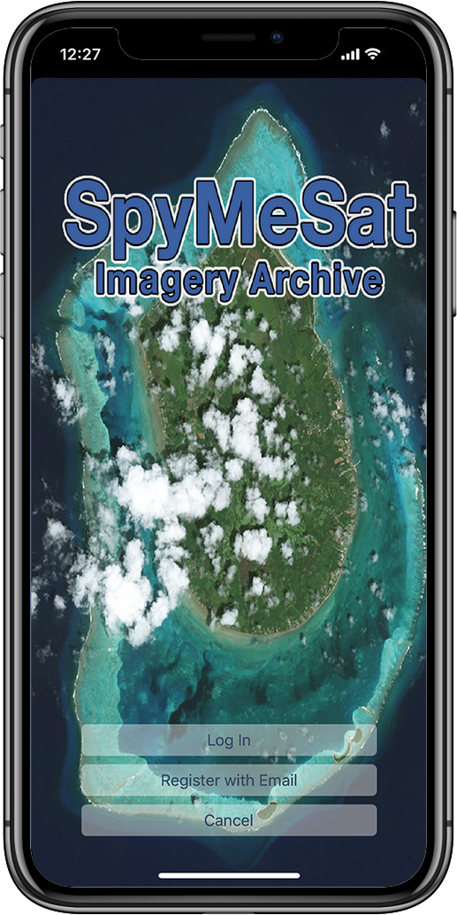
SpyMeSat Imagery Archive Account
With a SpyMeSat account the user can store images on the SpyMeSat cloud and re-download purchased images, and make new tasking requests
Reached from the bottom of the Settings page
Automatically syncs purchased images across multiple user devices
Registering for a SpyMeSat account is required to purchase archive images and to request new tasking
U.S. PATENTS 9344994 and 9779301

Slide 13
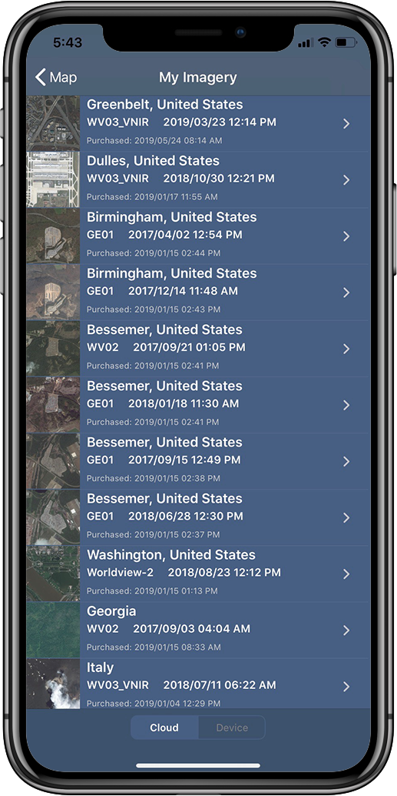
My Satellite Imagery
Reached from the SpyMeSat Imagery page by selecting the View button
All purchased images and image details are stored here, including status of tasked images
The cloud tab shows the images loaded on the device and images the user has stored on the SpyMeSat cloud.
The user is able to re-download any purchased images from the cloud in seconds
The Device tab will only show the user the images that are currently stored on the device
U.S. PATENTS 9344994 and 9779301

Slide 14
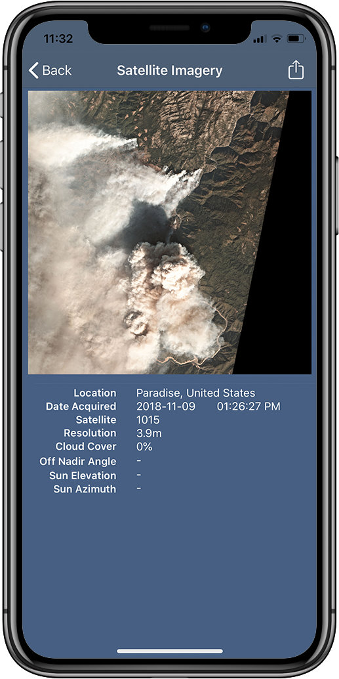
View and Share!
Once the user has purchased an image it can be viewed within the SpyMeSat app or sent to external applications for viewing
Here you can see the Image Location, Date Acquired, Time Acquired, and the Satellite
The user also has the ability to share the JPEG image (via Email, Facebook, etc.) using the top right box/arrow icon
U.S. PATENTS 9344994 and 9779301

Slide 15
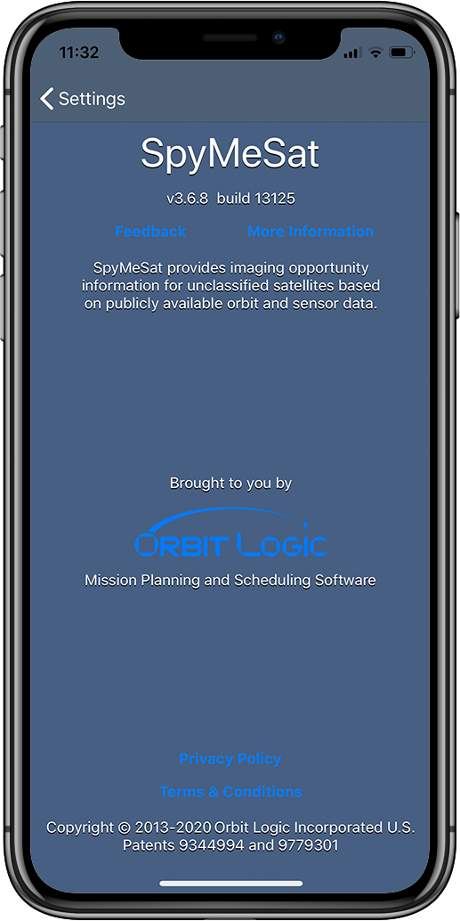
About Page
Reached from a button at the top of the Settings/Configuration page
Provides a link to www.spymesat.com for additional information
Provides a button to generate a feedback email that is sent to the Orbit Logic SpyMeSat app team at spymesat@orbitlogic.com
Provides a logo button to take the user to the Orbit Logic website
Provides some disclaimer information, privacy policy and terms of use links, and patent information
U.S. PATENTS 9344994 and 9779301

Slide 16
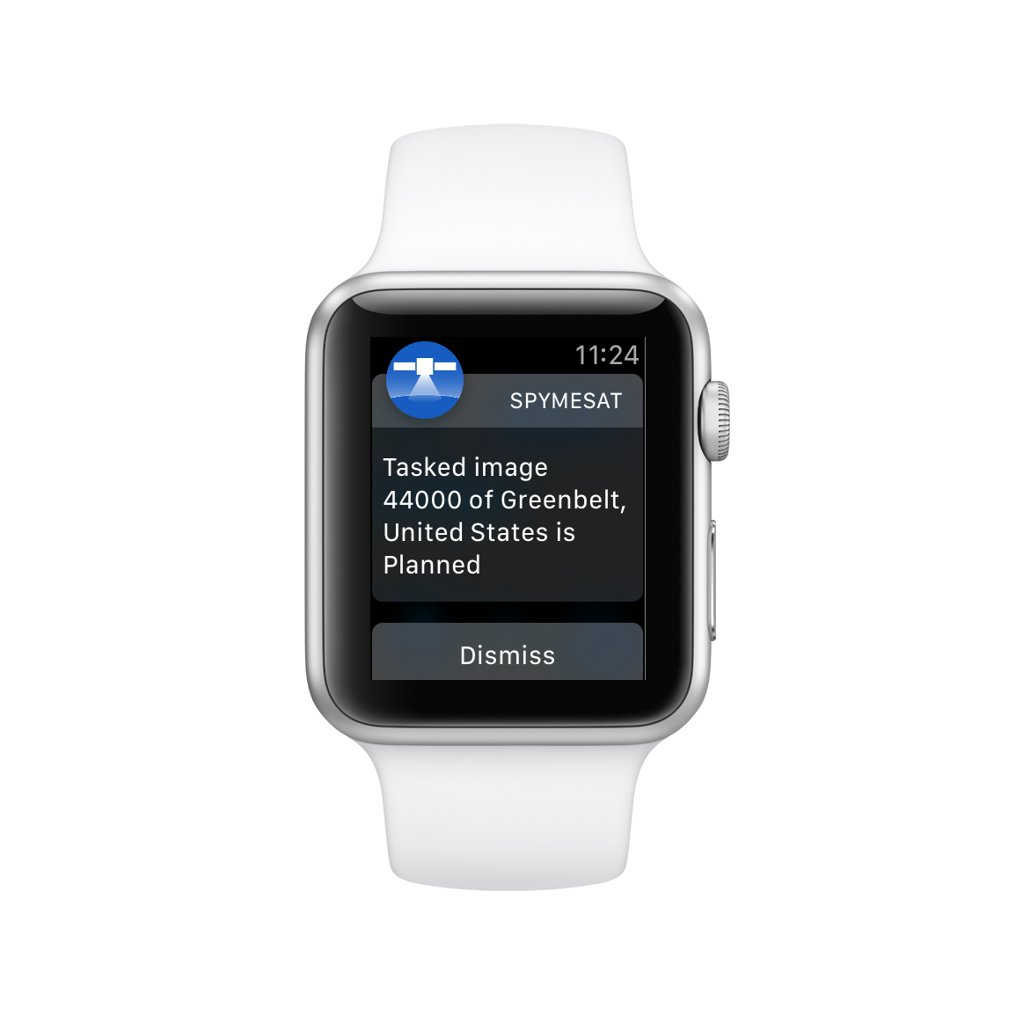
Apple Watch
SpyMeSat notifications and reminders appear on your Apple Watch
Enable this through the Apple Watch app on your iPhone
Apple Watch App
Overflight countdowns and color coding appear on the watch and in the Dock
U.S. PATENTS 9344994 and 9779301

Slide 17
Why SpyMeSat?
“When I speak with people outside the space industry about what I do they are always very interested and have many questions about satellites and imaging satellites in particular.
I realized that there was a place for an app that provided information, education, and awareness about imaging satellites . . . and access to the latest satellite imagery.
SpyMeSat is the result . . . and it’s lots of fun!”
Alex Herz
President, Orbit Logic Incorporated

Slide 18
Sources of Data
SpyMeSat uses only publicly available orbit data from NORAD published on www.celestrak.com
SpyMeSat uses only publicly available satellite and sensor data (usually from the satellite operator’s own website)
SpyMeSat does not use any proprietary satellite data
SpyMeSat does not include any classified satellite from any nation
U.S. PATENTS 9344994 and 9779301

Slide 19
Custom Solutions
Customized mobile apps based on SpyMeSat can be quickly implemented:
Any desired set of satellites
Any desired source of orbit data
Any desired imagery archive(s)
White-labeling/rebranding
Dedicated SpyMeSat Server available
Integration with Order Logic web application for order management and feasibility checks
Integration with CPAW for satellite collection planning and mission planning
U.S. PATENTS 9344994 and 9779301

Slide 20
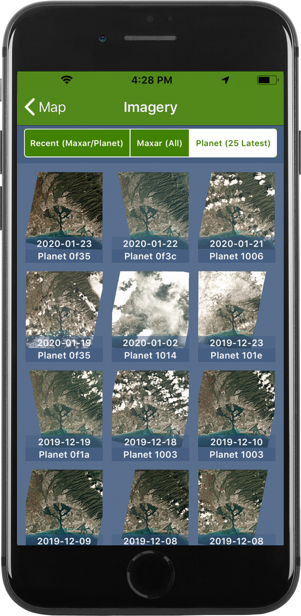
SpyMeSatGov (custom solution for NGA)
Based heavily on the SpyMeSat consumer app
Available for download from NGA’s Geoint App Store
Tasking removed due to NGA legal concerns
Requires separate logins for access to the Maxar and Planet archives
U.S. PATENTS 9344994 and 9779301

Slide 21
For More Information
Download the app from the Apple App Store or Google Play
Visit the SpyMeSat website at www.spymesat.com
Send app feedback or questions to spymesat@orbitlogic.com
Visit the Orbit Logic website at www.orbitlogic.com
Call or email Alex Herz at Orbit Logic
alex.herz@orbitlogic.com
301-982-6233
Visit us or send us snail mail (please call or email to pre-arrange a visit)
Orbit Logic Incorporated
7852 Walker Drive, Suite 400
Greenbelt, MD 20770

Slide 22
New Vendor Onboarding
For imaging satellite operators who want to join the SpyMeSat marketplace . . .
Send standard Reseller Agreement and related product specifications, pricing and order form(s)
May require revisions for mobile app purchase workflow
Send archive imagery API information
Thumbnails
Full resolution imagery products
Provide Tasking Request API information
As an alternative, Orbit Logic can provide an email ICD for tasking
Tasking workflow: request, confirm, planned, acquired, delivered
U.S. PATENTS 9344994 and 9779301

Slide 23
Security
General
iTunes and Google Play not generally available in countries under U.S embargo or to people on Denied Parties list
Archive Image Purchase
Image purchase disabled if Location Services is off or not available to the SpyMeSat app
Image purchase disabled if current location is within an embargoed country
Embargoed country list changed monitored automatically and Orbit Logic personnel alerted of any changes (SpyMeSat server updated as needed)
New Tasking
Region constraints applied (can be satellite-specific)
Requires user registration including name, address, and country of citizenship
Requires payment method including verification of billing address
Denied parties check made at registration and at new tasking requests
Denied parties list updated automatically through daily SpyMeSat server interaction with Treasury and State Department websites
Orbit Logic personnel notified of any attempts by denied parties to initiate new tasking
Denied party user receives generic-looking “server error” at purchase attempt
U.S. PATENTS 9344994 and 9779301

